Slide 1
ENGLISH AS A SECOND LANGUAGE
ESL PARENT ORIENTATION
North Allegheny School District
September 14, 2020

Slide 2
Introductions
Dr. Erin Crimone
Principal, NACA
Mrs. Carla Hudson
Assistant Principal, NACA
Mrs. Amy DeGregorio ESL 3-5
Miss Melissa Zarra ESL K-2
ESL Specialists
Notes:
Talk about whose relevant for you

Slide 3
ESL Classroom Expectations
Student Expectations
*Keep video on as much as possible
*Keep yourself on mute unless called on
*No food or snacks during live class
*Dress appropriately
*Be in a safe place with no distractions
Parent Expectations
*We appreciate your help! Especially, with any technical difficulties and learning to navigate on the iPad.
*Please remember to try not translate everything the teacher is saying.
*Also, we want to see the work your child is able to do independently, so we can plan their lessons to help.
Notes:
Talk about whose relevant for you

Slide 4
ESL Magnet Program
English Language Learners (ELLs) attend magnet schools to deliver services more effectively and efficiently. Students are reassigned to the magnet school for all instruction, eliminating shuttle transportation between schools and loss of instructional time for students.
Magnet Schools | Feeder Schools
Marshall Elementary | Bradford Woods Elementary
McKnight Elementary | Franklin Elementary Hosack Elementary Ingomar Elementary Peebles Elementary
Carson Middle School | Ingomar Middle School
North Allegheny Intermediate School | North Allegheny Senior High School

Slide 5
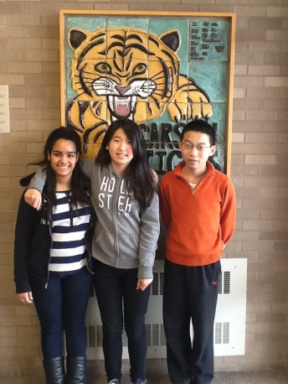
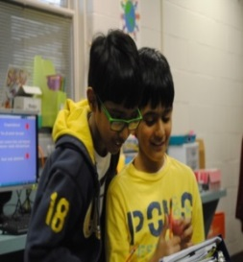
Who Are Our English Language Learners?
What is English as a Second Language?
English as a Second Language (ESL) is teaching the skills of Listening, Speaking, Reading, and Writing in an educational environment at appropriate developmental levels with little or no use of the native language.

Slide 6
How are ESL Classes Scheduled?
Depending upon your child’s current proficiency level (English skill level), students may receive up to 2 hours of ESL instruction per day.
ESL instruction occurs primarily during English Language Arts (ELA) or “WIN” (English/Reading).
Group instruction may be provided by combining students from more than one grade level and varying proficiency levels.
Children may have more than one ESL Specialist per year.

Slide 7
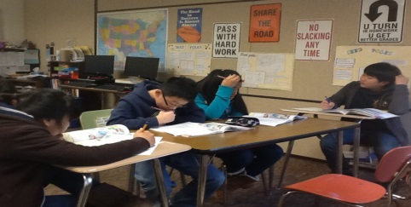
What Does ESL Instruction Look Like?
ESL Classes Allow For:
Individualized instruction
Adequate pacing
Active participation
More repetition
Greater focus on specific needs of students
Frequent communication

Slide 8
What ESL Materials and Resources are Implemented?
CURRICULUM
Wonders for ELLs
The curriculum is standards-based with specialized instructional strategies.
It has online components that teachers and students may utilize in the classroom and students can access at home.

Slide 9
2020-2021 ACCESS for ELLs 2.0
An online assessment - ACCESS for ELLs 2.0 for grades 1 through 12 that assesses each of the four language domains of Listening, Speaking, Reading, and Writing
Kindergarten and Alternate ACCESS for ELLs assessments are paper-based.
The ACCESS for ELLs and the WIDA Screener measure your child’s English Proficiency Level using this scale:
Entering – 1
Emerging – 2
Developing – 3
Expanding – 4
Bridging – 5
Reaching-6

Slide 10
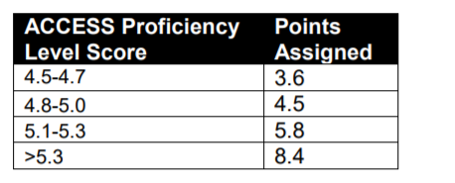
What is the ESL Reclassification or Exit Criteria?
The Pennsylvania Department of Education has established the following ESL Reclassification or Exit Criteria to determine when a student no longer requires ESL Services. To meet the required state exit criteria, students must meet the required exit criteria:
Required Exit Criteria
A composite score of 4.5 or above on the WIDA ACCESS for ELLs 2.0
Higher scores earn more “ACCESS for ELLs” points
A combined score of 10.5 points from the ACCESS for ELLs points and “language use inventories”

Slide 11
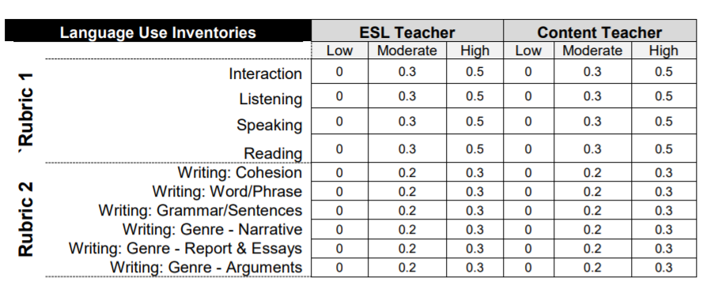
ESL Reclassification
Each language use inventory produces a single score and the sum of the two inventory scores is added to the ACCESS for ELLs® points assigned to determine if the student meets the minimum threshold for reclassification. → 10.5 points or higher

Slide 12
ESL Reclassification
The ACCESS test will be given between January 4th and February 19th this year. There are 4 parts which may be given on different days. Please let your child’s ESL teacher know if your child will be absent during this window.
ACCESS test scores are usually released in June
ACCESS score reports and reclassification notifications will be sent to your home over summer vacation.

Slide 13
ESL Communication
We communicate through e-mail, phone calls, scheduled conferences, and information sent home:
Parents to teachers
Teachers to parents
Parents to school
CHAIN OF COMMAND:
Teacher 🡪 Principal 🡪Director of Elementary Education Dr. James Bradley
Refer to Ten Most Frequently Asked Questions Pamphlet
Notes:
Personalize to building

Slide 14
ESL District Resources
ESL Website
Find ESL teachers’ web pages and emails, overview of the program, and information on resources and important events.
How do I access?
1. Go to www.northallegheny.org (Select Language)
2. Click on the Departments & Offices tab.
3. Select Student Services.
4. On the left side of the page, click the ESL Program tab.
5. You are now on the ESL page.

Slide 15
ESL Resources
Foreign Language Translating Service
TransPerfect is a telephone service that provides translators in 180 languages, 365 days a year.
TransPerfect may be used for emergencies; ESAP, PPT, or IEP meetings; conferences; or at parent(s)/guardian(s) request.
NorthAllegheny.org → “select language” tab at the top
iPad → google translate app (can use camera & microphone)

Slide 16
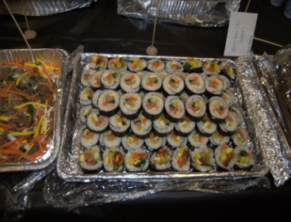
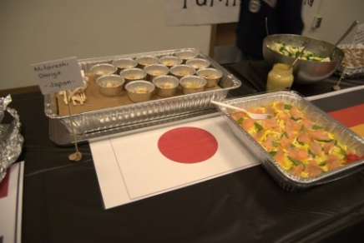
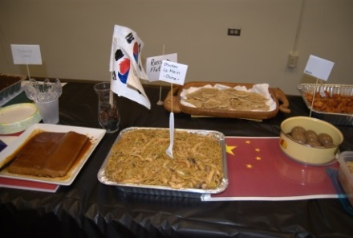
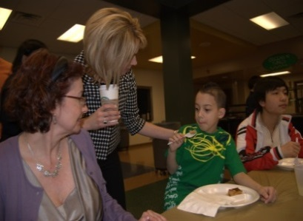
Dates to Remember
Elementary Conferences
Thursday, November 12th OR Friday, November 13th
Please sign-up for a conference either Thursday, November 12th from 12:00-7:45 p.m. or Tuesday, November 13th from 8:00 a.m. – 3:45 p.m.
ESL Family Night
Thursday, March 18, 2021 at 6:00 p.m. at
McKnight Elementary
A night of families, food, and fun! Come and meet with other ESL families in the District. Taste foods from all around the world and bring a dish from your own culture to share!

